Slide 1
Topic D: Fields AHL D.4 – Induction
Guiding questions
What are the effects of relative motion between a conductor and a magnetic field?
How can the power output of electrical generators be increased?
How did the discovery of electromagnetic induction effect industrialization?
Notes:
© 2015 by Timothy K. Lund

Slide 2
Topic D: Fields AHL D.4 – Induction
Students should understand:
• magnetic flux Φ as given by Φ = BA cos θ
• that a time-changing magnetic flux induces an emf ε as given by Faraday’s law of induction ε = − NΔΦ/Δt
• that a uniform magnetic field induces an emf in a straight conductor moving perpendicularly to it as given by ε = BvL
• that the direction of induced emf is determined by Lenz’s law and is a consequence of energy conservation
• that a uniform magnetic field induces a sinusoidal varying emf in a coil rotating within it
• the effect on induced emf caused by changing the frequency of rotation.
Notes:
‹#›
© 2015 by Timothy K. Lund

Slide 3
Topic D: Fields AHL D.4 – Induction
Guidance:
Examples of production of an induced emf should include:
• time-varying magnetic fields
• coils rotating within a uniform magnetic field
• relative motion between a conductor and a magnetic field (for example, a magnet oscillating on a spring above a conducting coil, or a coil moved in or out of the region of a magnetic field).
A quantitative treatment of induced emf will be restricted to straight conductors moving at right angles to
magnetic fields and rectangular coils moving in and out of fields and rotating in fields.
Only a qualitative treatment of self-induction is required.
A discussion of inductance and resistance-inductor (RL) circuits is not required.
Notes:
‹#›
© 2015 by Timothy K. Lund

Slide 4
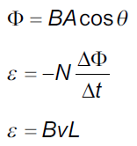
Topic D: Fields AHL D.4 – Induction
Data booklet reference:
Notes:
‹#›
© 2015 by Timothy K. Lund

Slide 5
Topic D: Fields AHL D.4 – Induction
Electromotive force (emf)
∙Consider the magnetic field (B-field) provided by a horseshoe magnet ( a curved bar magnet).
∙If we place a stationary charge q within the B-field, it will feel NO MAGNETIC FORCE.
∙Yet if we project the charge q through the B-field with a velocity v it will feel a force:
North
South
F = qvB sin φ
magnetic force on a moving charge
where φ is angle between v and B
Notes:
© 2015 by Timothy K. Lund

Slide 6
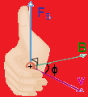
Topic D: Fields AHL D.4 – Induction
Induced electromotive force (emf)
∙It should thus come as no surprise that moving a piece of wire (a conductor) through a magnetic field produces a magnetic force on the charges in the moving wire:
∙Don’t forget the right-hand-rule!
+
v
B
Notes:
© 2015 by Timothy K. Lund

Slide 7
Topic D: Fields AHL D.4 – Induction
Induced electromotive force (emf)
∙Consider this new experiment: If the north pole of a magnetic is suddenly thrust through a looped conductor, a current is created.
T or F: Current travels through the circuit only while the magnet is moving through the loop.
T or F: Current direction depends on which direction the magnet is being moved through the loop.
0
-
+
Notes:
© 2015 by Timothy K. Lund

Slide 8
Topic D: Fields AHL D.4 – Induction
Induced electromotive force (emf)
∙Since moving a conductor through a magnetic field produces a current, this very action must therefore induce an electromotive force (emf) in the conductor.
∙Since moving a magnetic field trough a conductor produces a current, this very action must therefore induce an emf in the conductor.
∙We have shown, therefore, that all we need is relative motion between a conductor and a magnetic field in order to induce an emf.
FYI
∙This is the principle behind electricity generation using turbines and generators. Motion of a conductor through a B-field produces an emf which can drive a current.
Notes:
© 2015 by Timothy K. Lund

Slide 9
Topic D: Fields AHL D.4 – Induction
Induced electromotive force – straight wire through B
EXAMPLE: Show that the emf ε induced in a straight conductor of length L moving at velocity v through a magnetic field of strength B is
SOLUTION: Note that since v B then φ = 90º:
F = qvB sin φ = qvB sin 90º = qvB.
Recall that E = V / x = V / L and that F = qE.
Since F = qE = qV / L and F = qvB, we have
qV / L = qvB
V = BvL = ε.
∙The IBO expects you to derive this formula.
ε = BvL
induced emf in a straight wire
where v and B are perpendicular
Notes:
© 2015 by Timothy K. Lund

Slide 10
Topic D: Fields AHL D.4 – Induction
Induced electromotive force – straight wire through B
PRACTICE:
The Boeing Dreamliner, having wingspan of 60 m, is flying through Earth’s magnetic field near Tuscon (B = 56 μT) at 265 ms⁻¹. Treating the wing as a straight wire, find the induced emf from wingtip to wingtip.
SOLUTION:
ε = BvL = (56×10⁻⁶)(60)(265) = 0.90 V.
FYI
∙Sometimes weaker magnetic field strength is measured in gauss instead of tesla.
∙The conversion is 1 gauss = 10⁻⁴ tesla.
∙Thus the B in this example is B = 0.56 gauss.
Notes:
© 2015 by Timothy K. Lund

Slide 11
Topic D: Fields AHL D.4 – Induction
Magnetic flux
∙Consider the experiment where the plane of the loop is in the same plane as the moving magnetic field:
T or F: Because of the orientation of the loop most of the magnetic field lines to NOT pass through the area of the loop.
T or F: There is no current generated in this experiment.
0
-
+
Notes:
© 2015 by Timothy K. Lund

Slide 12
Topic D: Fields AHL D.4 – Induction
Magnetic flux
(1)
PRACTICE: Compare the B-field lines that intersect the area of a loop in Case 1: the B-field is parallel to the plane of the loop, and in Case 2: the B-field is perpendicular to the plane of the loop.
SOLUTION:
∙In (1) note that the loop has no B-field lines passing through it.
∙In (2) note that the loop has many rows of B-field lines passing through it.
(2)
FYI
∙The moving-magnet experiments showed that the induced emf depends on the relative orientations of the B-field and area.
Notes:
© 2015 by Timothy K. Lund

Slide 13
Topic D: Fields AHL D.4 – Induction
Magnetic flux
∙Because of the importance in orientation between the area A of the loop and the magnetic field B, a new quantity called magnetic flux Φ is here defined.
∙Obviously we have to somehow define the direction of an area. Quite simply, the direction of an area is perpendicular (or normal) to the plane of that area.
Φ = BA cos θ
θ is angle between A and B
magnetic flux
B
∙Note that as θ → 90º, Φ → 0.
direction of circle
direction of rectangle
∙At θ = 90º, no B-field lines “pierce” A.
A
A
circular area ( πr ² )
rectangular area ( L×W )
A
Notes:
© 2015 by Timothy K. Lund

Slide 14
Topic D: Fields AHL D.4 – Induction
Magnetic flux
PRACTICE:
Find the magnetic flux in each case. In each case the strength of the B-field is 1.5 T and the area is 0.20 m².
SOLUTION: Use Φ = BA cos θ.
(1) θ = 0º so Φ = 1.5(0.20) cos 0º = 0.30 T m².
(2) θ = 30º so Φ = 1.5(0.20) cos 30º = 0.26 T m².
(3) θ = 90º so Φ = 1.5(0.20) cos 90º = 0.0 T m².
(4) θ = 150º so Φ = 1.5(0.20) cos 150º = ⁻0.26 T m².
(5) θ = 180º so Φ = 1.5(0.20) cos 180º = ⁻0.30 T m².
Note that Φ can be negative.
B
B
B
B
1
2
3
4
5
B
A
30º
A
A
30º
A
A
Notes:
© 2015 by Timothy K. Lund

Slide 15
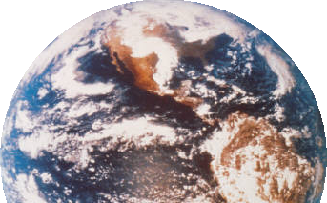
Topic D: Fields AHL D.4 – Induction
Solar flux – a comparison
∙Recall from Topic 8.5 that although the intensity of radiation from the sun is I =1380 W m⁻² when it reaches our orbit, it is spread out over progressively larger areas.
∙We define the solar radiation flux to be Φ = IA cos θ. The I vector has a value of 1380 W m⁻². The area vector has a magnitude of 1.00 m². θ is the latitude.
A
I
θ
1380 W/m²
Notes:
© 2006 By Timothy K. Lund

Slide 16
Topic D: Fields AHL D.4 – Induction
Solar flux – a comparison
PRACTICE: Find the solar flux per square meter at latitude 40° N. Ignore the tilt of Earth for this calculation.
SOLUTION:
Φ = IA cos θ = 1380(1) cos (180° – 40°) = -1057 W m².
FYI
∙The significance of the (-) sign is that the flux ENTERED the surface, rather than exited it.
A
I
θ
1380 W / m²
Notes:
© 2006 By Timothy K. Lund

Slide 17
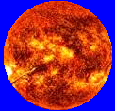
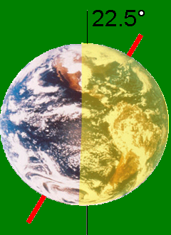
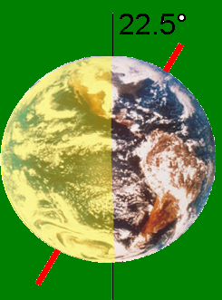
Topic D: Fields AHL D.4 – Induction
Solar flux – a comparison
PRACTICE: Find the solar flux per square meter at latitude 40° N in the northern hemispheric winter and summer. This time include the 22.5 ° tilt. Then label the images “summer” and “winter”.
SOLUTION: Use Φ = IA cos θ with “corrected” θ:
Φ_{win} = 1380(1) cos [180° – (40° + 22.5°)] = -637 W m².
Φ_{sum} = 1380(1) cos [180° – (40° – 22.5°)] = -1316 W m².
summer
winter
Note that Φ_{sum} is twice that of Φ_{win}.
Notes:
© 2006 By Timothy K. Lund

Slide 18
Topic D: Fields AHL D.4 – Induction
Define magnetic flux and magnetic flux linkage.
∙Magnetic flux is measured in T m² which are also known as webers (Wb). Thus 1 T m² = 1 Wb.
∙We define the magnetic flux density as the magnetic flux per unit area. Thus
magnetic flux density = Φ / [A cos θ].
∙But from the definition of magnetic flux we see that
magnetic flux density = Φ / [A cos θ]
magnetic flux density = BA cos θ / [A cos θ]
magnetic flux density = B.
Magnetic flux density
FYI
∙Be aware that the magnetic flux density and magnetic field strength are the same thing-namely the B-field.
Notes:
© 2015 by Timothy K. Lund

Slide 19
Topic D: Fields AHL D.4 – Induction
Magnetic flux linkage
∙If instead of a single loop we make a coil of N loops, the flux Φ through each loop is “linked” to each of the other loops in what is termed flux linkage.
∙Each loop produces its own emf, and the emfs from each loop add to the total emf.
∙Note that an emf is only produced while the flux is changing.
flux linkage = NΦ
flux linkage
N is the number of loops
0
-
+
Notes:
© 2015 by Timothy K. Lund

Slide 20
Topic D: Fields AHL D.4 – Induction
Induced electromotive force
∙As all of our demonstrations have shown, only while the flux is changing does an emf get produced.
∙Since flux Φ = BA cos θ, there are three ways to change the flux:
(1) Change the B-field.
(2) Change the area A.
(3) Change the relative orientation θ of A and B.
0
-
+
FYI
∙Recall that (3) is the way a generator produces electricity at a power plant. A coil in a generator is rotated by a turbine, thus changing θ.
Notes:
© 2015 by Timothy K. Lund

Slide 21
Topic D: Fields AHL D.4 – Induction
Induced electromotive force
EXAMPLE: Explain why when the switch is closed in the first circuit, the ammeter in the second reads a current for an instant.
SOLUTION:
While the switch is open there is no current through the black coil and thus no B-field.
The instant the switch is closed, current flows and a B-field is created by the black coil.
While the B-field is growing, the blue coil intercepts it, and its magnetic flux begins to grow, too, thus inducing an emf in the blue coil.
Once the B-field becomes steady the flux stops changing, and the induced emf drops back to zero.
A
This is the principle behind radio and TV.
Notes:
© 2015 by Timothy K. Lund

Slide 22
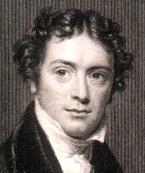
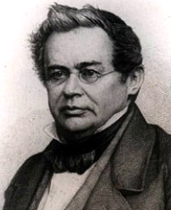
Topic D: Fields AHL D.4 – Induction
Faraday’s law of induction and Lenz’s law
∙Faraday’s law states that the emf induced in a coil is equal to the rate of change in the flux linkage in the coil.
∙Lenz’s law states that an induced current will have a direction such that it will oppose the change in flux that produced it. This is the significance of the (-) sign in Faraday’s law.
ε = – N ΔΦ / Δt
Faraday’s law
Ignore the (-) if direction is not needed.
PRACTICE: Suppose the magnetic flux in the presence of a coil having 240 loops is changing at a rate of 0.25 Wb s⁻¹. What is the induced emf?
SOLUTION: Use N = 240 and ΔΦ / Δt = 0.25.
ε = N ΔΦ / Δt = 240(0.25) = 60. V.
Notes:
© 2015 by Timothy K. Lund

Slide 23
Topic D: Fields AHL D.4 – Induction
Faraday’s law of induction and Lenz’s law
EXAMPLE: Explain why when the switch is closed in the first circuit, the induced current produces a flux change that is opposite to the original flux change.
SOLUTION:
∙Suppose the induced flux change were NOT opposite.
∙Then the induced flux change would ADD to the original, thus inducing a runaway flux change leading to infinite induced current!
∙Clearly this is NOT possible. It violates conservation of energy. Thus by reductio ad absurdum we see that Lenz’s law is a statement of conservation of energy.
A
Notes:
© 2015 by Timothy K. Lund

Slide 24
Topic D: Fields AHL D.4 – Induction
Faraday’s law of induction and Lenz’s law
PRACTICE: Watch the experiment. The maximum voltage is about 18 V.
(a) What would be the effect, if any, of reversing the magnetic so that the south pole goes in first?
(b) What would be the effect of doubling the oscillation speed of the magnet?
SOLUTION:
(a) The sign of the flux would be reversed so that the meter would reverse. Thus on moving the magnet to the right the meter would deflect left.
(b) Since the Δt in ΔΦ / Δt would be cut in half, so the emf would double to about 36 V.
ε = -N
ΔΦ
Δt
Magnet reversal → cos(180º+ θ) = - cos θ.
Notes:
© 2015 by Timothy K. Lund

Slide 25
Topic D: Fields AHL D.4 – Induction
Faraday’s law of induction and Lenz’s law
PRACTICE: Watch the experiment. The maximum voltage is about 18 V.
(c) At the original oscillation rate, what would you predict the voltage induced in a single loop to be?
(d) If there were 150 loops, what would the voltage be?
SOLUTION:
(c) From ε = N ΔΦ / Δt we see that
18 = 7( ΔΦ / Δt )
2.6 V = ΔΦ / Δt (the emf for each loop)
(d) 150×2.6 = 390 V.
1234567
ε = -N
ΔΦ
Δt
Notes:
© 2015 by Timothy K. Lund

Slide 26

Topic D: Fields AHL D.4 – Induction
Faraday’s law of induction and Lenz’s law
PRACTICE: Watch the experiment. The maximum voltage is about 18 V.
(d) Determine the direction of the induced current in the first loop of the coil while the magnet is moving right.
SOLUTION:
(d) Lenz’s law states that the induced current will try to oppose the flux increase.
∙Since the B-field is increasing right, the B-field created by the induced current will point left.
∙Using the right hand rule for coils, the current should flow anticlockwise as seen from the left.
ε = -N
ΔΦ
Δt
I
Notes:
© 2015 by Timothy K. Lund

Slide 27
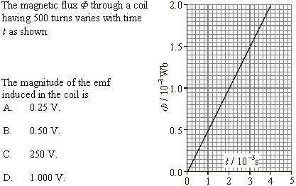
Topic D: Fields AHL D.4 – Induction
Electromagnetic induction problems
∙ΔΦ / Δt = 2×10⁻³ / 4×10⁻³ = 0.5.
∙N = 500.
∙ε = N ΔΦ / Δt
= 500(0.5)
= 250 V
Notes:
© 2015 by Timothy K. Lund

Slide 28
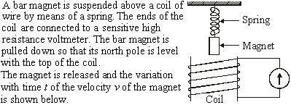
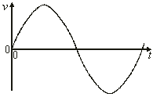

Topic D: Fields AHL D.4 – Induction
∙ε is maximum when change in flux is maximum.
Electromagnetic induction problems
M
M
∙Change in flux is maximum when v is maximum.
Notes:
© 2015 by Timothy K. Lund

Slide 29

Topic D: Fields AHL D.4 – Induction
∙ε is zero when change in flux is zero.
Electromagnetic induction problems
Z
Z
Z
∙Change in flux is zero when v is zero.
Notes:
© 2015 by Timothy K. Lund

Slide 30

Topic D: Fields AHL D.4 – Induction
Electromagnetic induction problems
∙The magnet is oscillating because of the spring.
∙Thus the B-field is oscillating, and hence the flux linkage is oscillating.
∙Hence the induced emf is oscillating because of Faraday’s law (and Lenz’s law).
Notes:
© 2015 by Timothy K. Lund

Slide 31
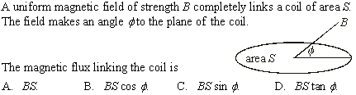
Topic D: Fields AHL D.4 – Induction
Electromagnetic induction problems
θ
∙Magnetic flux is given by Φ = BA cos θ where θ is the angle between the B-field and the NORMAL to the area.
∙Thus Φ = BS cos θ = BS cos( 90º – φ ) = BS sin φ.
FYI
∙Beware of the IBO. They will try to catch you off of your guard. No, really.
∙Don’t forget the identity cos( 90º – φ ) = sin φ.
Notes:
© 2015 by Timothy K. Lund

Slide 32
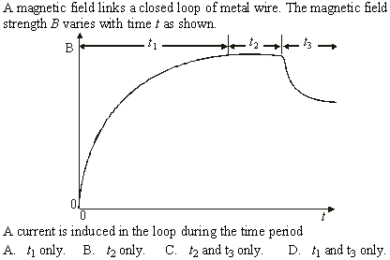
Topic D: Fields AHL D.4 – Induction
Electromagnetic induction problems
∙A current will be induced if the magnetic flux is changing.
∙The magnetic flux is changing whenever the magnetic field is.
Notes:
© 2015 by Timothy K. Lund

Slide 33
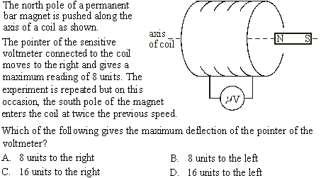
Topic D: Fields AHL D.4 – Induction
Electromagnetic induction problems
∙Reversed pole → reversed deflection: LEFT.
∙Doubled speed → doubled emf: 16 units.
Notes:
© 2015 by Timothy K. Lund

Slide 34
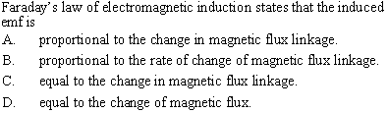
Topic D: Fields AHL D.4 – Induction
Electromagnetic induction problems
∙Use Faraday’s law: ε = – N ΔΦ / Δt
time rate
change in magnetic flux linkage
FYI
∙Only one choice is a RATE.
∙Remember that flux linkage has the N in it whereas flux does not.
Notes:
© 2015 by Timothy K. Lund

Slide 35
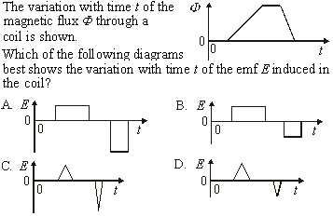
Topic D: Fields AHL D.4 – Induction
Electromagnetic induction problems
less steep
more steep
∙E is proportional to the slopes (E =ΔΦ / Δt).
∙E is thus constant where the slopes are.
Notes:
© 2015 by Timothy K. Lund

Slide 36
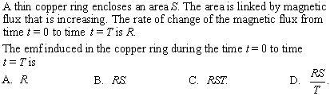
Topic D: Fields AHL D.4 – Induction
Electromagnetic induction problems
∙Faraday’s law says that the induced emf is equal to the rate of change of the magnetic flux.
∙Be sure to read the questions CAREFULLY and COMPLETELY.
Notes:
© 2015 by Timothy K. Lund

Slide 37
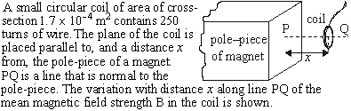
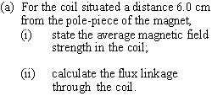
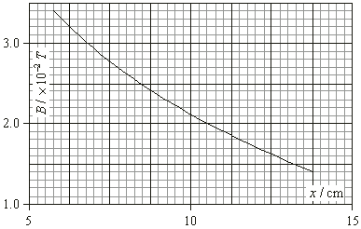
Topic D: Fields AHL D.4 – Induction
∙flux link. = NΦ
= NBA cos 0º
Electromagnetic induction problems
= NBA
A
B
∙B = 3.3×10⁻² T.
∙NBA = 250(3.3×10⁻²)(1.7×10⁻⁴) = 0.0014 Wb.
Notes:
© 2015 by Timothy K. Lund

Slide 38


Topic D: Fields AHL D.4 – Induction
Electromagnetic induction problems
B = 1.7×10⁻² T.
∙NBA = 250(1.7×10⁻²)(1.7×10⁻⁴) = 0.0007 Wb.
∙ΔNBA = 0.0014 - 0.0007 = 0.0007 Wb.
Notes:
© 2015 by Timothy K. Lund

Slide 39

Topic D: Fields AHL D.4 – Induction
Electromagnetic induction problems
∙ε = N ΔΦ / Δt
∙ε = 0.0007 / 0.35 = 0.002 V.
Notes:
© 2015 by Timothy K. Lund

